Slide 1
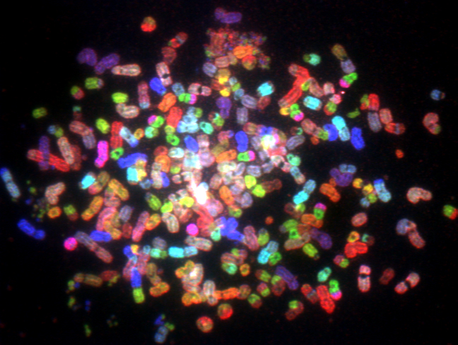
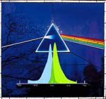
George McNamara, Ph.D.
Spectral Imaging Microscopy Web Sites And Data
George McNamara, Amit Gupta, James Reynaert, Thomas D. Coates, Carl Boswell 2006
Cytometry 69A: 863-871. See also Garini et al Cytometry 69A: 735-747.
The 12th Annual Southeast Ultrafast Conference
University of Central Florida, Orlando, Florida
January 15-16th, 2009

Slide 2
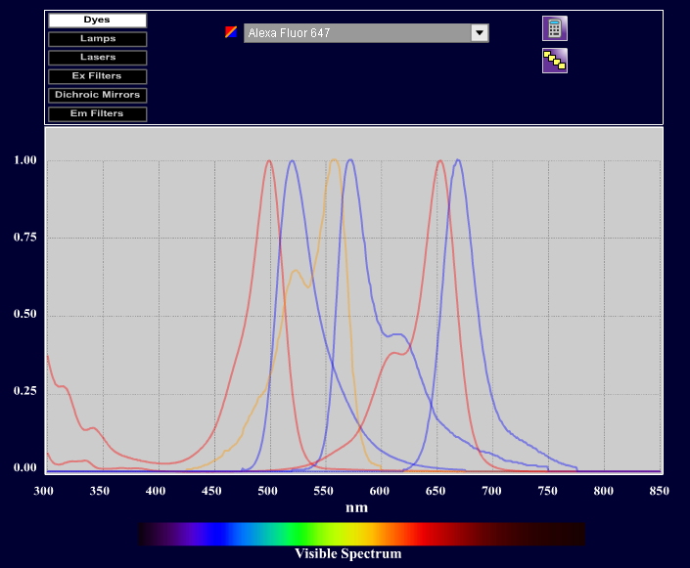
U Arizona Fluorescence Dye Spectra Web Site
http://www.mcb.arizona.edu/ipc/fret/indexb.html
Alexa Alexa
Fluor Fluor
488 Cy3B 647

Slide 3
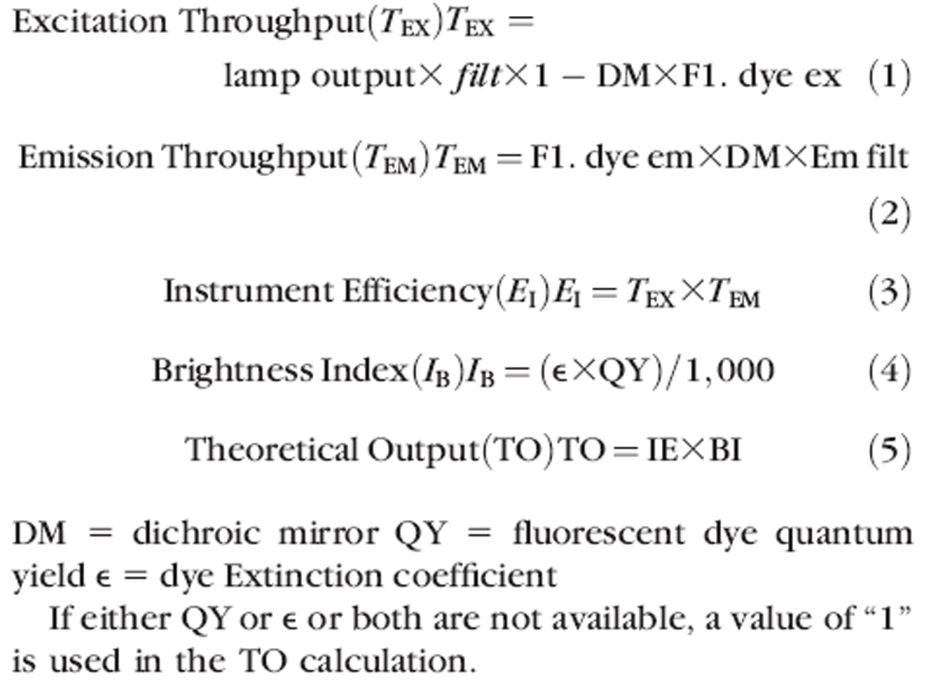
U Arizona Fluorescence Dye Spectra Web Site
http://www.mcb.arizona.edu/ipc/fret/indexb.html
McNamara et al 2006 Cytometry A 69(8): 863-871.

Slide 4
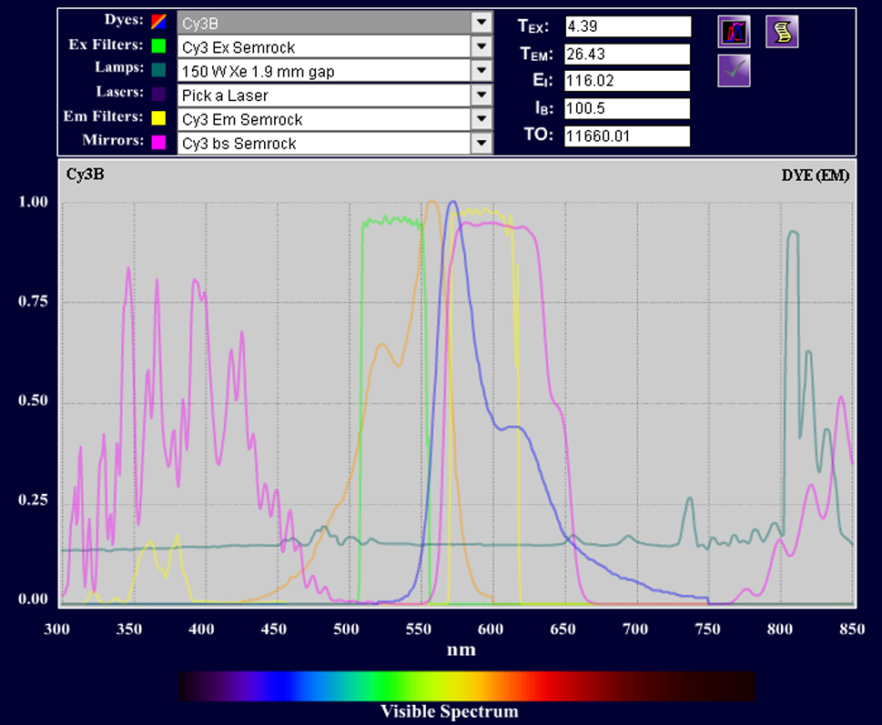
U Arizona Fluorescence Dye Spectra Web Site
http://www.mcb.arizona.edu/ipc/fret/indexb.html
Total output (TO)
Cy3 613
Cy3B 11,660
Nearly identical dye spectra, Cy3B has higher quantum yield, due to rigid bond
Cy3 Cy3B
Ec 150,000 150,000
QY 0.04 0.67
McNamara et al 2006 Cytometry A 69(8): 863-871.

Slide 5
PubSpectra Web Site (get data file from George)
http://home.earthlink.net/~pubspectra/
(google: PubSpectra)
List of Files
Worked example (Excel table in PowerPoint)
Data Sources (PhotoChemCAD, Invitrogen/MPI, …)
1588 fluorescent dyes and fluorescent proteins
966 filters (Chroma, Omega, Schott, Semrock)
99 lamps, other
2653 spectra
Web links to Invitrogen/MPI, BD Biosciences,
Zeiss/Bio-Rad, PhotChemCAD, …

Slide 6
PubSpectra web site
Now:
Index file for the whole dataset:
McNamara_Boswell_000_2006_Index_Dyes_FPs_Filters_Lamps_Other_Spectra.xls
Zip files containing:
Fluorescent dyes and fluorescent proteins spectra:
McNamara_Boswell_Spectra_Dyes_FPs.zip
Filters spectra:
McNamara_Boswell_Spectra_Filters.zip
Light sources and other spectra:
McNamara_Boswell_Spectra_Lamps_other.zip
“Near Future” (single Excel 2007 “Big Grid” xlsx file:
http://www.sylvester.org/AICF

Slide 7
Spectra: To do list
Multiphoton excitation fluorophore spectra
Multiphoton laser power curves (laser, objective lens)
Objective lens transmission curves
Objective lens parfocality curves (re: multiphoton λs)
more Fluorophores, more FPs, Nanothingies, Luciferases
More abs dyes, drugs (indigo, indirubin …) Gurr, Green, Berlman …
more Filter sets (filters, sets, LCTFs …)
Digital cameras (CCD, CMOS), PMTs, APDs …
Accessories (liquid light guide, fibers, more lamps …)
More sources of data … student classwork?
… you?
Improved data header
Online FRET, BRET, LRET, QRET calculator

Slide 8
Model entire light path?
Lamp (Hg, Xe, HgXe, EmArc, 1p & MP lasers), heat filter(s) … fiber/LLG … collector lens … ex filter(s) … (optional) dm filter … objective lens … specimen [fluorophores, FRET?, autofluorescence] … objective lens … (optional) dm filter … em filter(s) … detector(s)
Dichroic (dm filter) optional - some instruments do not use epi-illumination:
Sawano & Miyawaki 2002 (5% reflection glass mirror vs DM)
Laser illumination narrow field epifluorescence microscopy (Yang & Musser)
stereofluorescence microscopes, macroscopes
new transmitted path condenser (CytoViva)
small animal imaging systems (Xenogen, VisEn Medical, Lightools)
New generation (“hard coat”, many layers) filters can be very effective at transmitting / blocking select wavelengths (Semrock, Chroma, Omega)

Slide 9
Filterology
Filter odds & ends
Objective lenses are not parfocal into NIR … would appropriate thickness glass filters (in em wheel) be worth pursuing? (substrate, optionally with wavelength selection. But each lens may need own correction).
    Related topic: Salmon Zikon DIC&GFP (DIC analyzer in wheel, ex & T shutters).
Any interest in 3 filters of different thickness (in cheap wheel) to do 3-plane Z-series for quantitative phase microscopy (QPm)?
How robust are the new filters to cleaning? (old filters get dusty).
Lifetime of filters vs that of scope? P.I.’s career? Relevant dyes?
“Zero pixel shift” vs repeatability of cubes and filter wheel?
Multifocus microscopy: slit apertures, linear variable spectral filters, SPIM

Slide 10
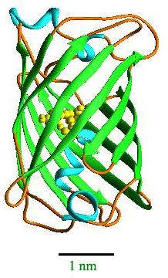
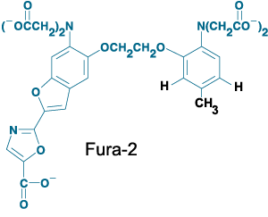
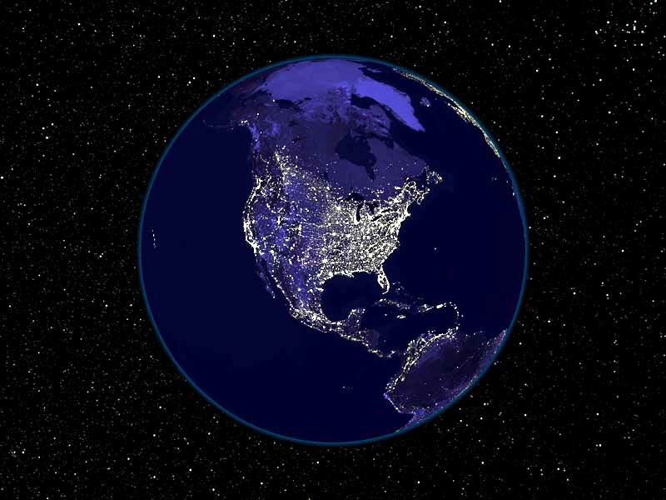
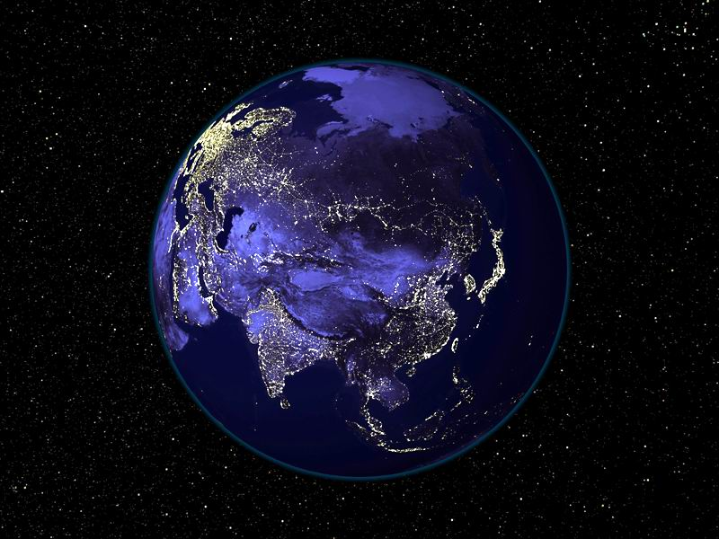
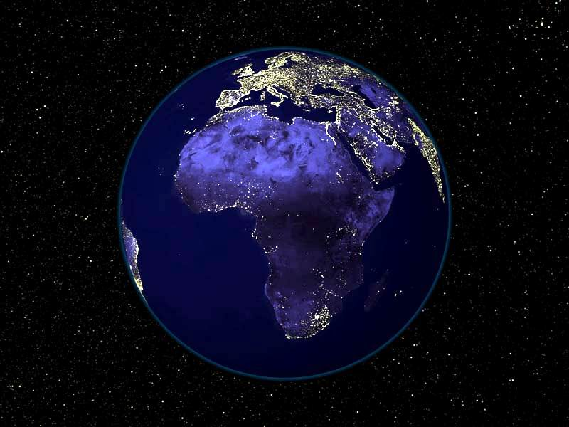
A thousand proteins of light
Data available on PubSpectra http://home.earthlink.net/~pubspectra/
Current Excel files posted May 15, 2006 (April files on PUCL CD)
946 FPs, 200+ Lucs data table (non-spectral)
McNamara 2006 Fluorescent Proteins Data
5000+ Dyes data table (non-spectral)
McNamara 2006 Fluorescent Proteins Data
1066 fluorescent proteins (946 Aequorea, Discosoma, related; + 120 fusions)
1019 phycobiliproteins (raw protein database dump, many partial)
120 phytochromes (phytofluors)
213 luciferases (not even close to complete)
http://www.capeaeroclub.co.za/photogallery/Earth%20At%20Night%202.jpg (1.jpg 2.jpg 3.jpg)
http://www-bioc.rice.edu/Bioch/Phillips/Papers/gfpbio.html

Slide 11
Why not sell the stuff?
“Greed is good.”
Gordon Gecko in Wall Street

Slide 12

Why not sell the stuff?
data are facts and facts cannot be copyrighted
http://home.earthlink.net/~pubspectra/DataNotCopyrightable.htm
McNamara et al 2006 Cytometry 69A: 735-747
Lawrence Lessig’s books
U.S. Constitution – patents and copyright act

Slide 13
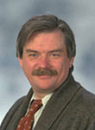
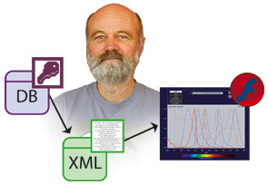
Acknowledgements
← Tom Coates, CHLA
Carl Boswell, Amit Gupta, James Reynaert (U. Arizona) →
Thanks to all who made data available:
Invitrogen/MPI, Jonathan Lindsey/PhotoChemCAD, Jack Goldsmith, Tsien/Campbell, Chroma, Omega, Semrock, …)
Yuval Garini, Bob Zucker, Jeremy Lerner, Richard Levenson, Fred Siedenburg,
ASI colleagues …
UA Spectra site received financial support from
Chroma Technology + UA web resources
and Carl would welcome more
http://www.mcb.arizona.edu/ipc/fret/default.htm
http://home.earthlink.net/~pubspectra
http://www.sylvester.org/AICF

Slide 14
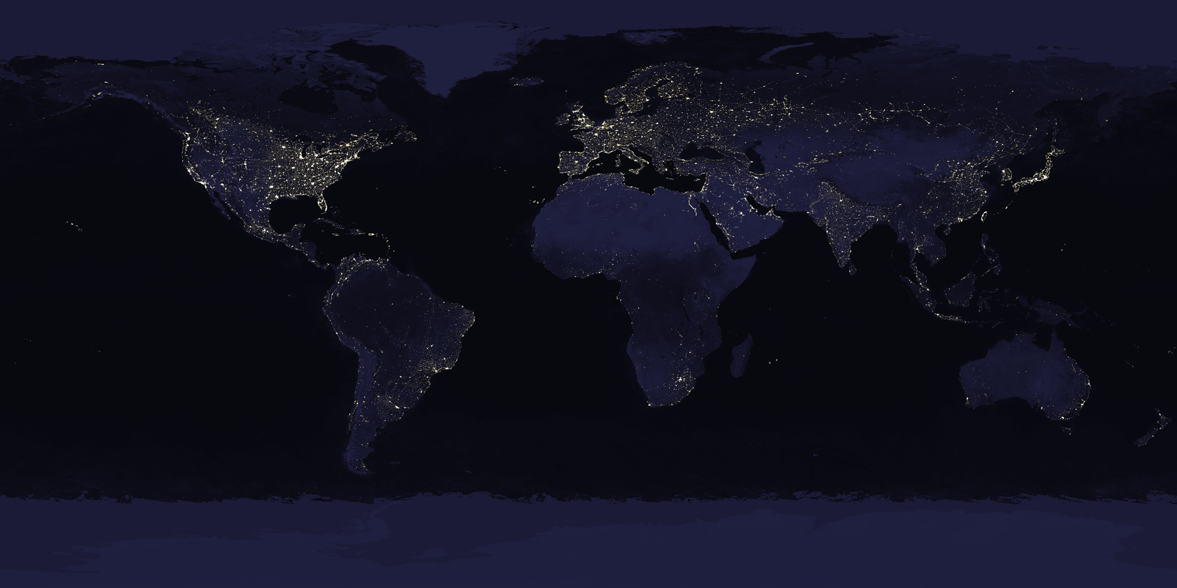
Thanks
Questions?
http://veimages.gsfc.nasa.gov/1438/land_ocean_ice_lights_2048.tif or http://visibleearth.nasa.gov/view_rec.php?id=1438

Slide 15
Tools of the trade
MetaMorph (Premier), MetaFluor
Adobe Photoshop CS2 / Fovea Pro 4.0
ImageJ (WCIF ImageJ distribution; micro-manager.org)
Microsoft Office (Excel, Word), PowerPoint
Silk Scientific’s Un-Scan-It 6
Adobe Acrobat, CutePDF freeware
X1 desktop search
World Wide Web (PubMed, JStor … )

